Slide 1
UNIVERSITY INSTITUTE OF COMPUTING
Bachelors of Computer Applications/Science
Project
23CAP-352
HOSPITAL MANAGEMENT SYSTEM
An Overview
of Computing
&
Career Planning
Student Name: Simranjeet Singh
UID: 23BCA10284
Section/Group: 23BCA-6 A
Supervisor Name: Mr. Ravinder Singh
Employee Code:
Designation:
DISCOVER . LEARN . EMPOWER

Slide 2
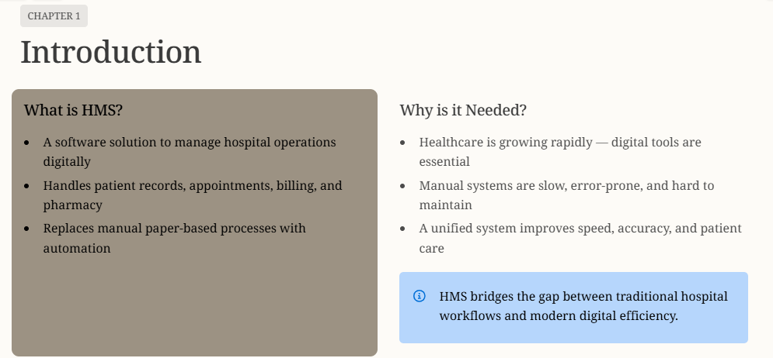

Slide 3
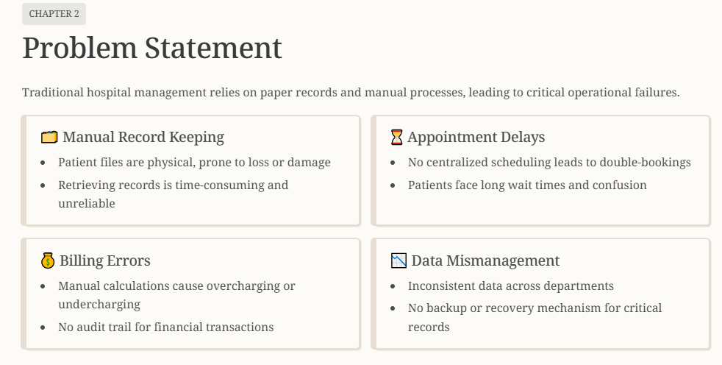

Slide 4
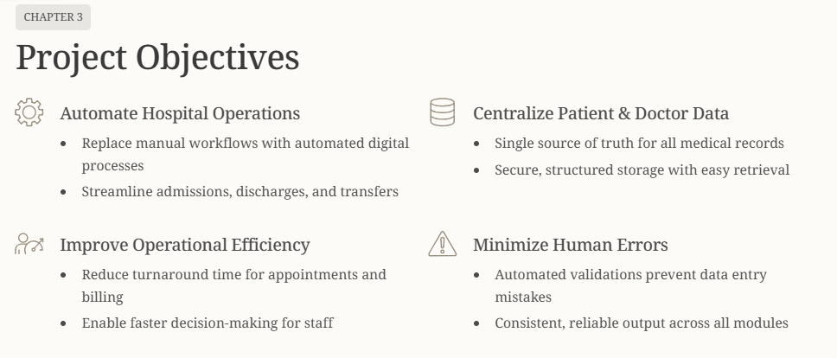

Slide 5
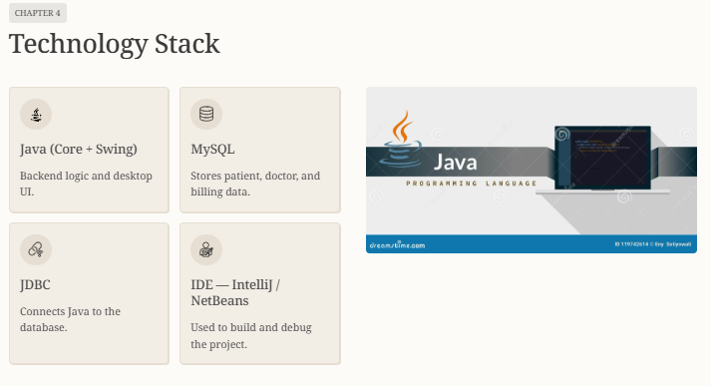

Slide 6
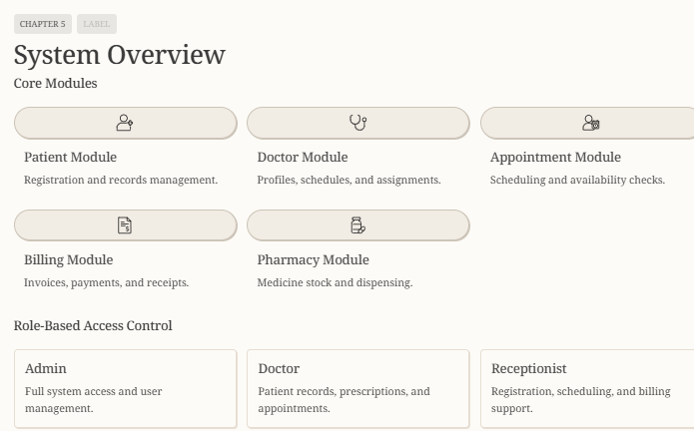

Slide 7
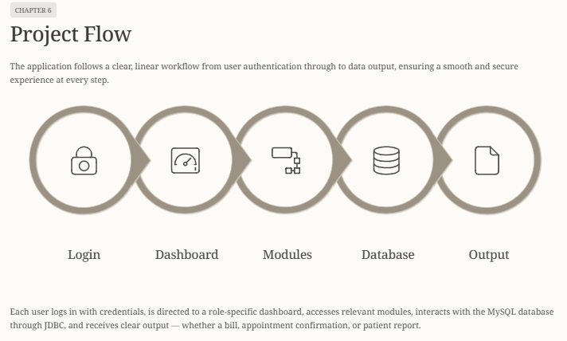

Slide 8
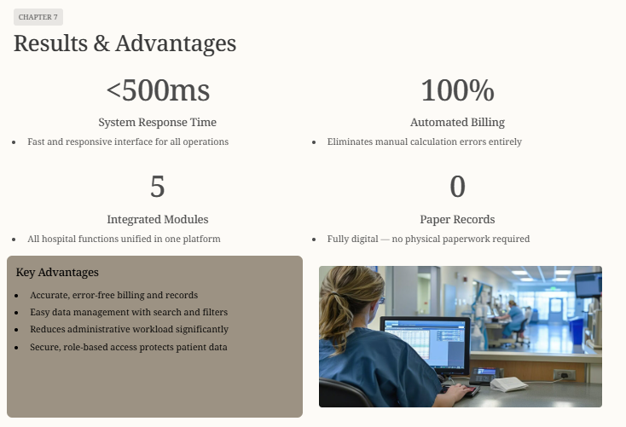

Slide 9
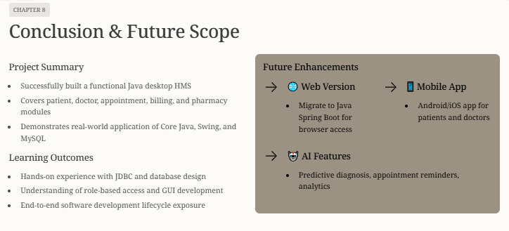

Slide 10
THANK YOU

